Slide 1
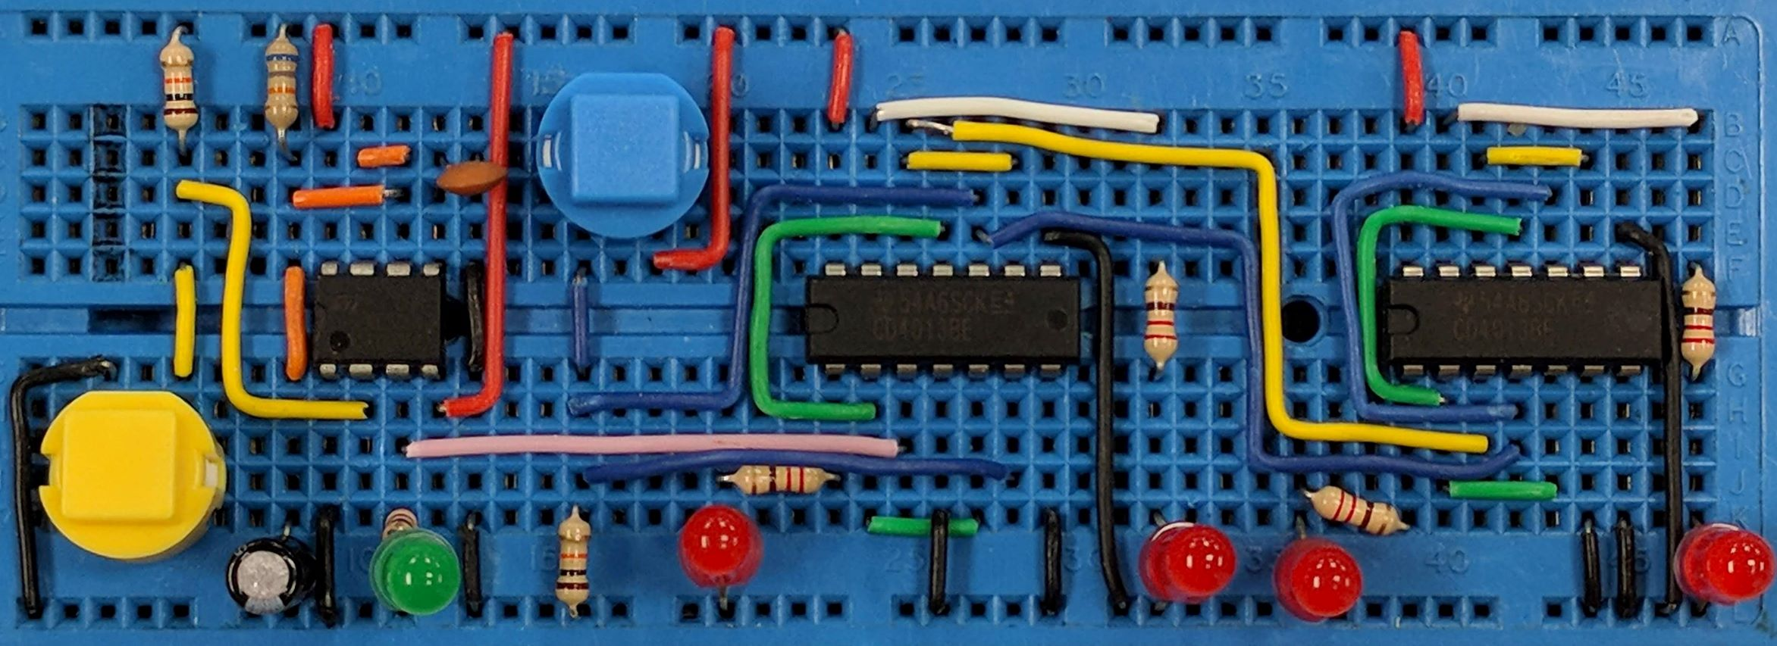
7 Segment Displays
AIM: To appreciate how to use a 7 Segment Display
PRIOR KNOWLEDGE: Diodes, Resistors
www.pfnicholls.com

Slide 2
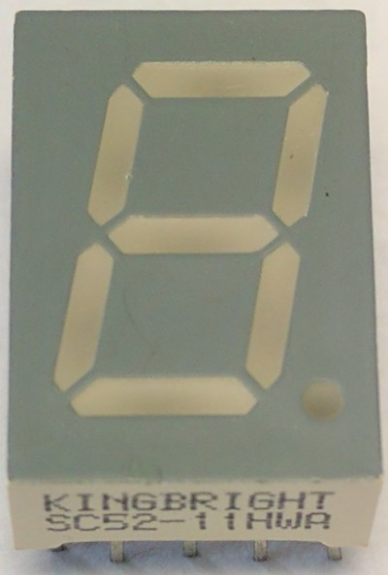
Introduction
The 7 segment display is an arrangement of 7 LEDs and a separate LED for the decimal place.
The display can form the digits 0-9 to display decimal numbers and can also form the letters A-F allowing Hexadecimal to be displayed.

Slide 3
Introduction
7 Segment displays come in different sizes and colours and have different forward bias voltages depending on how many LEDs make up each segment.
There are two types of display available - common cathode and common anode.
The number "SC52" on the 7 segment display shown means it is a common Cathode display.

Slide 4
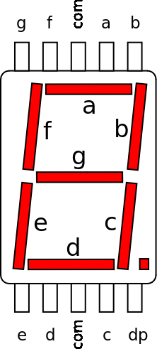
Connections
The LEDs in a 7 Segment Display usually need a series resistor.
7 Segment Displays are usually used with some form of counter and may need a decoder so that the correct segments are illuminated for each corresponding number, letter or symbol.
The diagram shows the connections for a typical 7 segment display

Slide 5
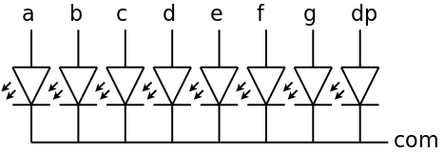
Common Cathode Displays
In a Common Cathode 7 Segment Display the cathodes of all eight LEDs are connected to a common pin which should be connected to 0 V.
Each separate segment of the display should have its own series resistor.
Each segment is made HIGH to illuminate the display. The display driver must be able to source current to the LEDs.

Slide 6
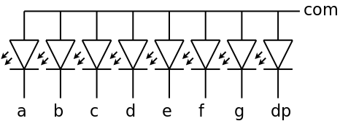
Common Anode Displays
In a 'Common Anode' 7 Segment Display, all eight anodes are connected to a common pin which is connected to the positive supply.
Each segment is connected separately to 0 V (made LOW) using a series resistor to illuminate the display. The display driver must be able to sink current from the LEDs.

Slide 7
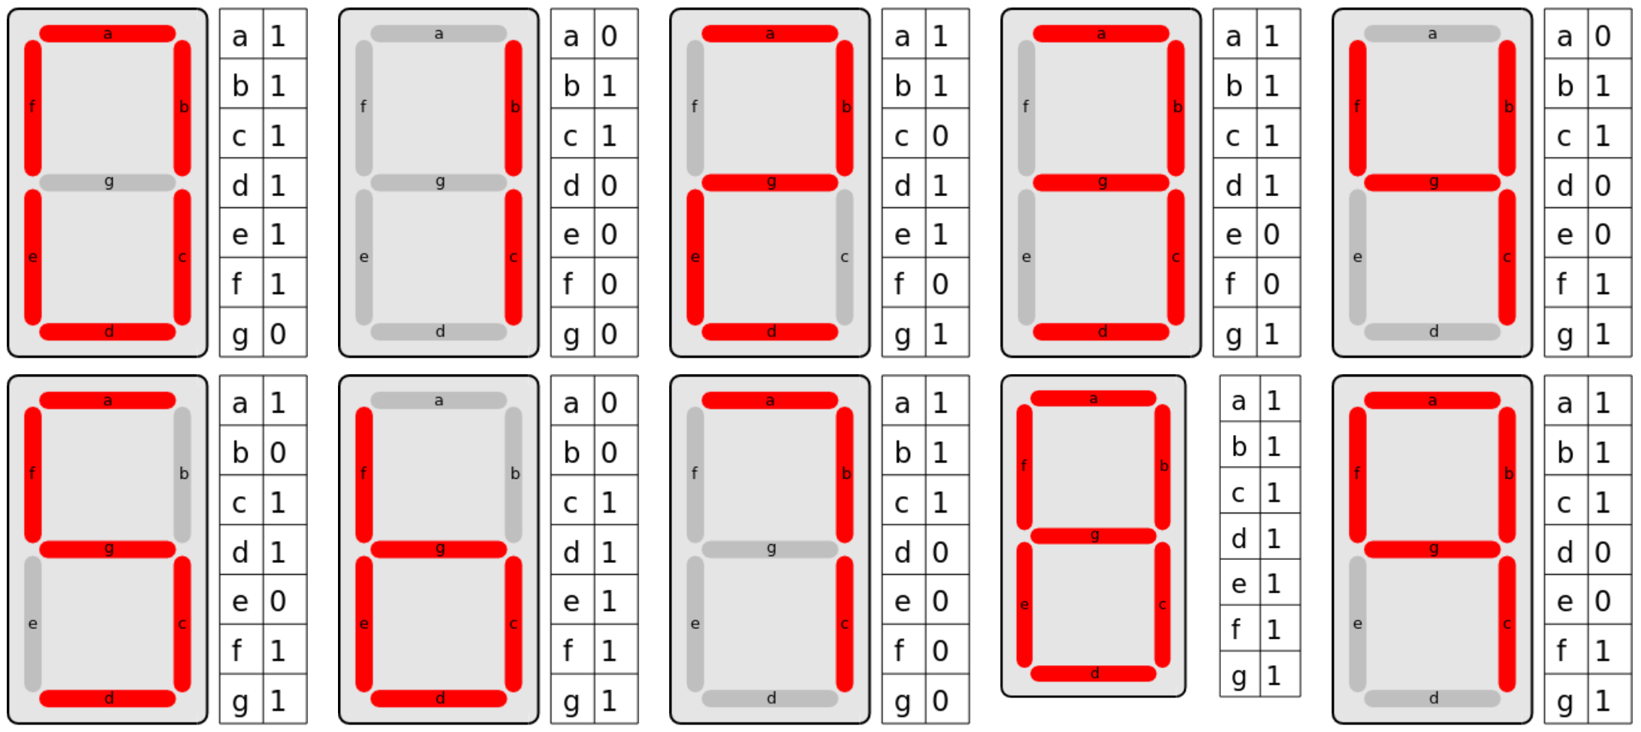
Displaying Numbers
The truth tables show how each number is formed by illuminating the appropriate segments.
The 1 is right justified and the 6 and 9 do not have tails.

Slide 8
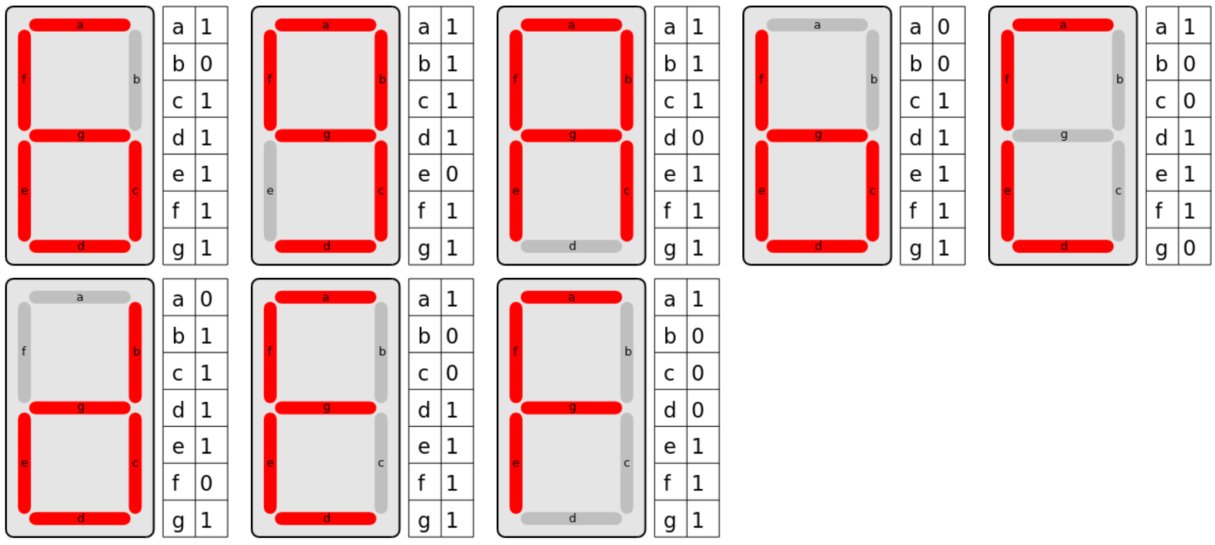
Displaying Hexadecimal
Hexadecimal is a number system that uses the numbers 0 to 9 and the letter A to F to give 16 different values.
Hexadecimal can be displayed on a 7 Segment Display BUT the 6 (and 9 for consistency) must have tails so that the letter "b" can be displayed and distinguished from a "6". The letters are displayed as A b C d E F.

Slide 9
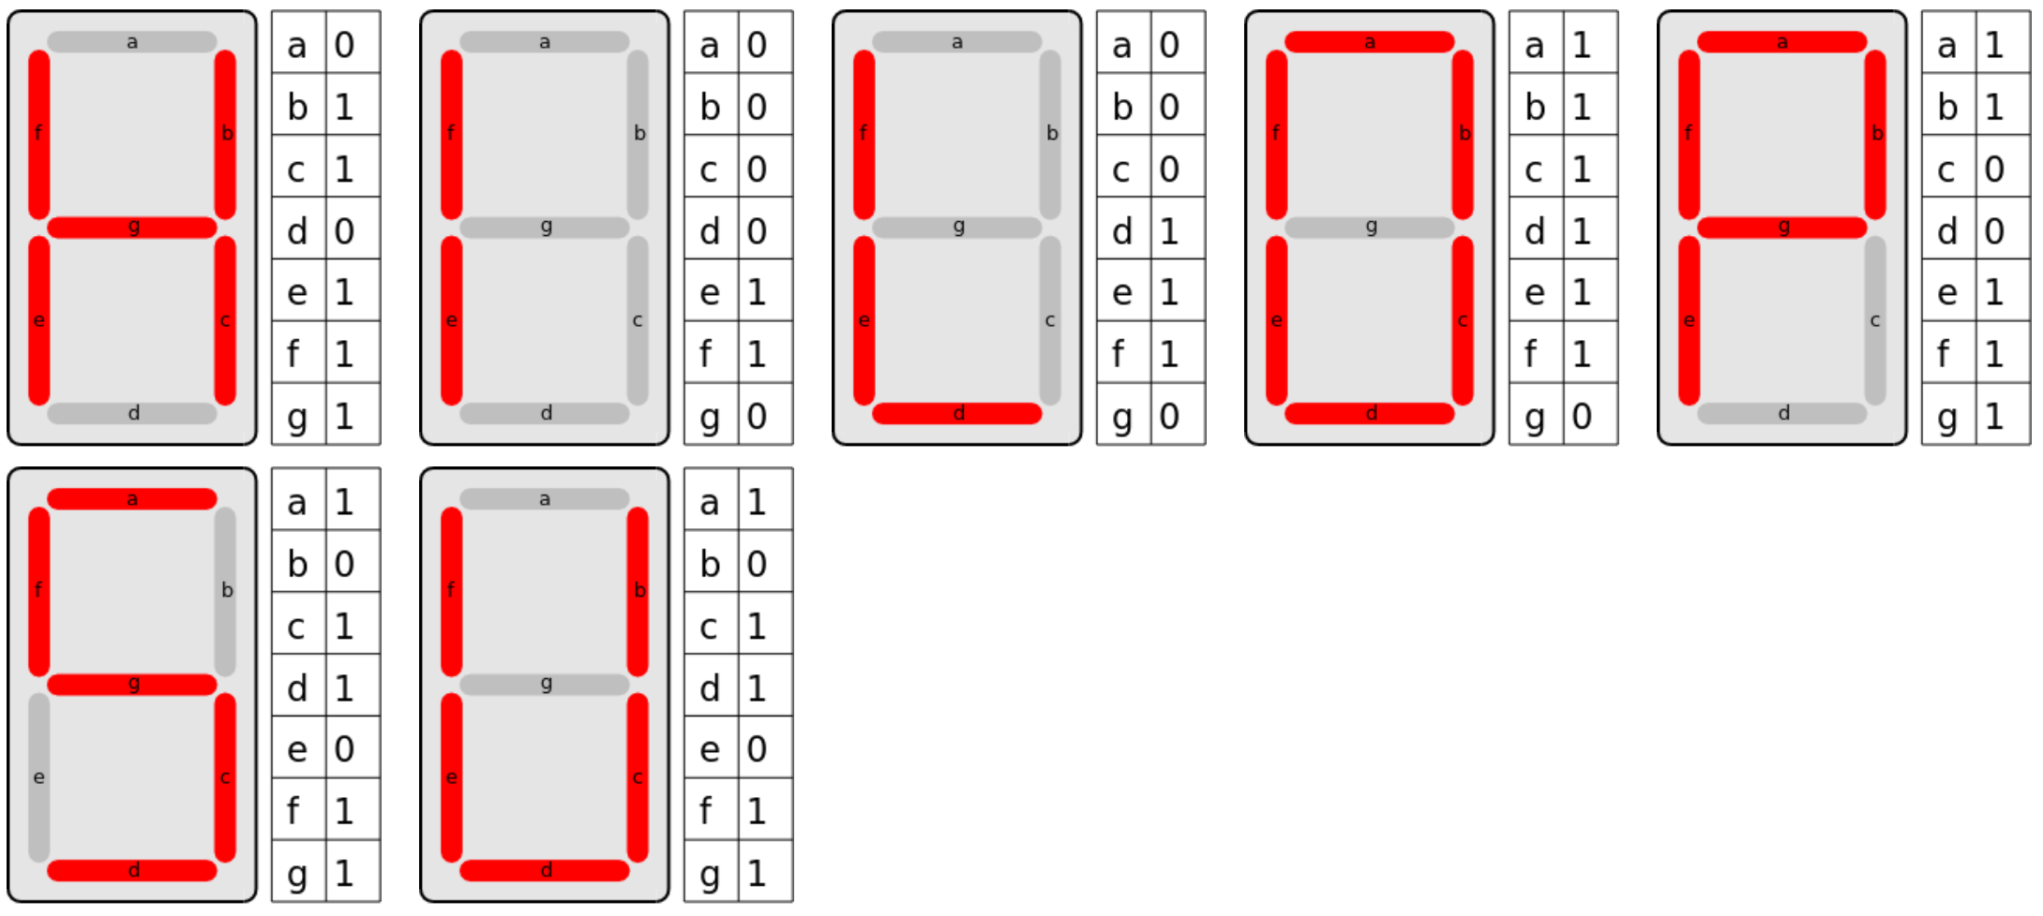
Displaying Letters – Upper Case
Common letters, in addition to those used for Hexadecimal, can be either upper or lower case.
Other letters can be displayed with a 7 Segment Display such as "y" and "n" which is useful for Yes / No (y/n).
Some letters are identical to numbers and so have to be used appropriately.

Slide 10
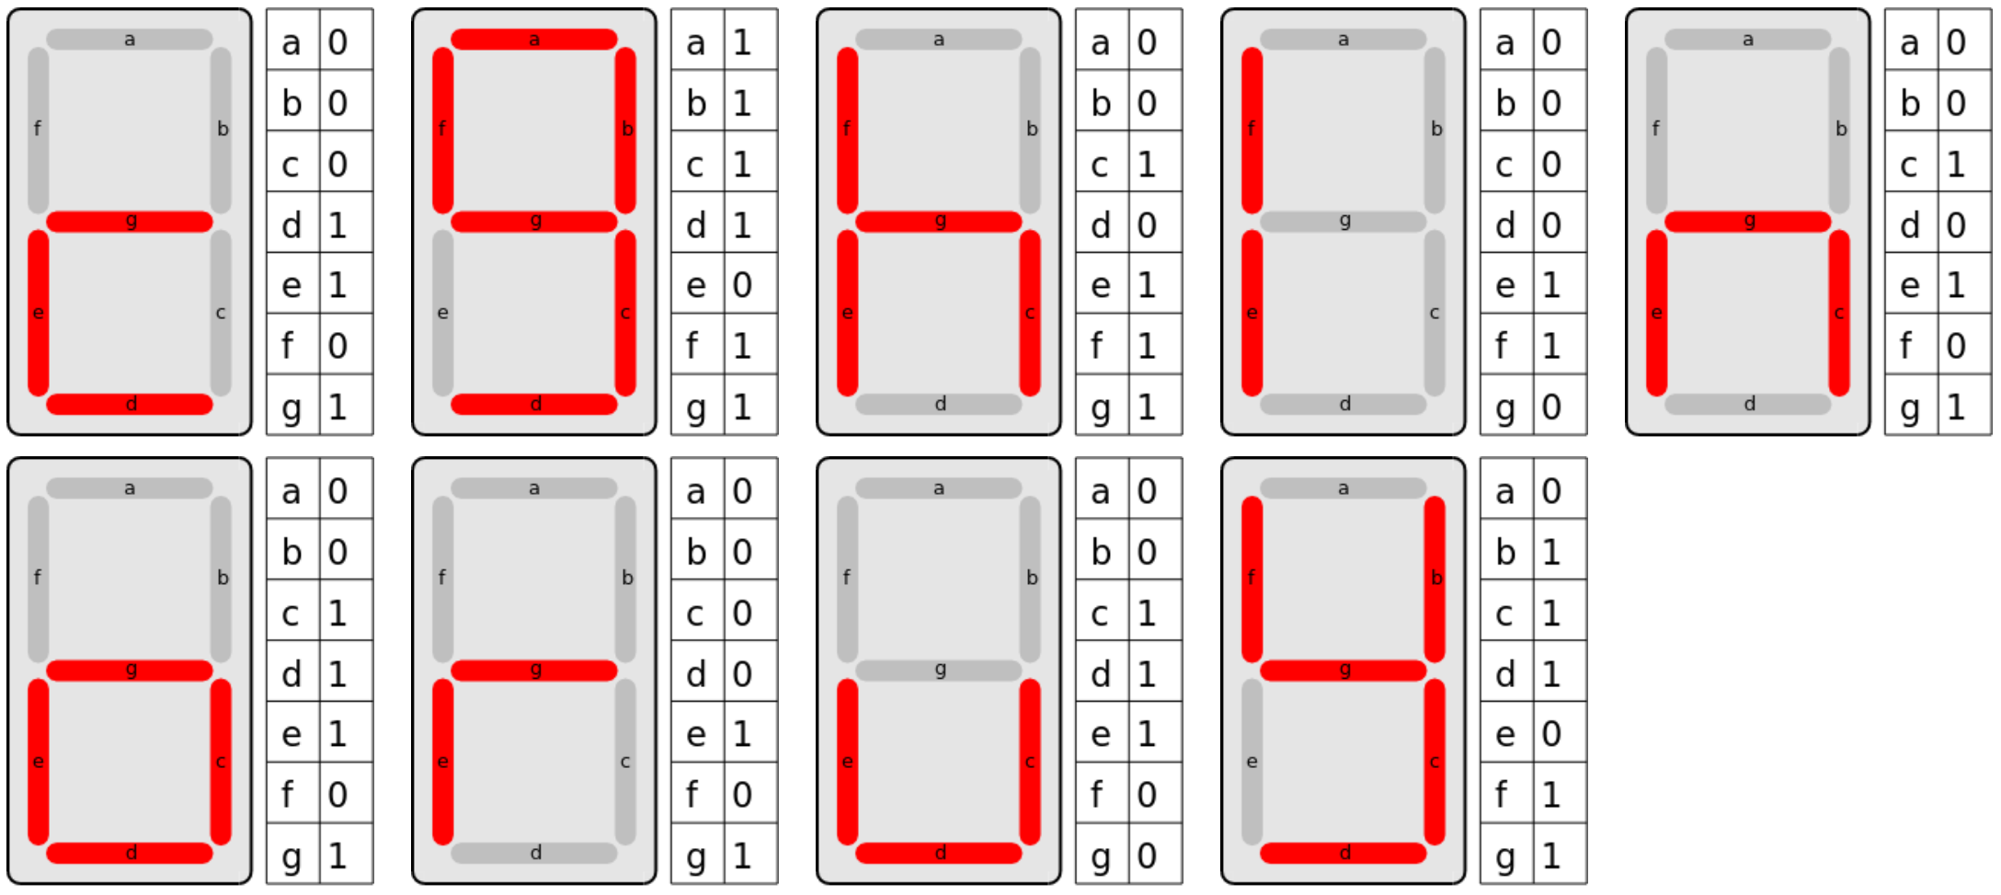
Displaying Letters – Lower Case
Text

Slide 11
Summary
A 7 Segment display is a series of LEDs arranged to make letters and numbers
There are 8 LEDs including the decimal point
A display decoder is usually used to convert binary (for example) into the correct outputs for the display
Common cathode displays have a common cathode connected to ground and each segment is made HIGH
Common anode displays have a common anode connected to positive and each segment is made LOW
Each LED needs a series resistor
Numbers, some upper case letters and some upper case letters can be displayed

Slide 12
Questions
How many LEDs are in a 7 segment display?
How many connections does a 7 segment display have?
Which numbers can be confused with letters?
Why are series resistors needed?

Slide 13
Answers
8 including the decimal place
9, these being the 8 LEDs and the common pin
1 confused with lower case l
confused with lower case b if the tails are not used
confused with lower case g if the tails are used
0 confused with upper case O
To limit the current. The segments of the display are just normal LEDs and need to be used in the same way

