Slide 1
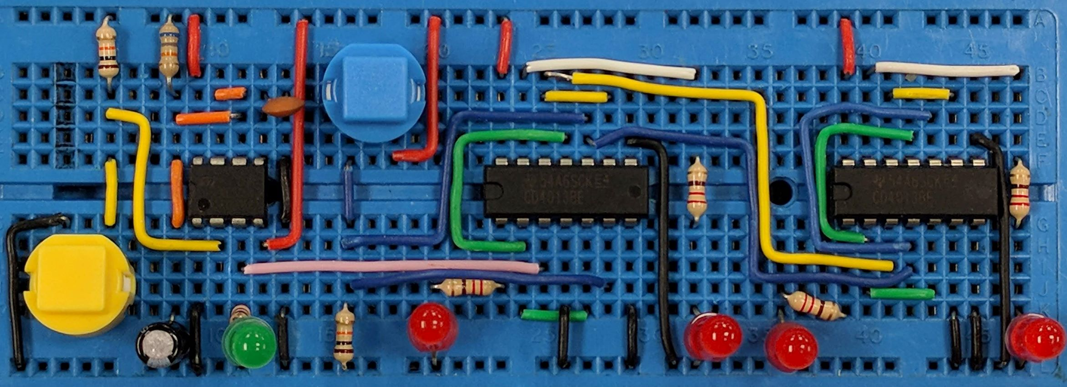
Electrical Safety
AIM:
To understand the dangers of electricity, know how to avoid injury and work safely and know what to do in an emergency
www.pfnicholls.com

Slide 2
Dangers of Electricity
Electricity is undoubtedly very important in our technological world. However, electricity can also be extremely dangerous.
With a little common sense and understanding, electricity can be used safely.
The main dangers of electricity are:
Electric shock: A small electrical current of just a few milliamps passing through the body can interfere with the electrical signals in the nervous system and cause muscle spasms.
A large electrical current has a significant heating effect and can cause burns (in the body) or electrical fires (in appliances).

Slide 3
Electric Shock
Electric Shock can result in:
A victim being unable to release a live electrical connection as the muscles in the hand tend to grip when subject to electric shock. If in doubt, touch a suspected live appliance with the back of the hand so that the fingers automatically pull away.
The victim being thrown backwards from a live appliance or, even worse, falling from ladders etc as they lose balance.
The victim losing consciousness and dying as the muscles of the heart stop working. This is most likely when electrical current flows through the chest, from one hand to the other for instance.

Slide 4
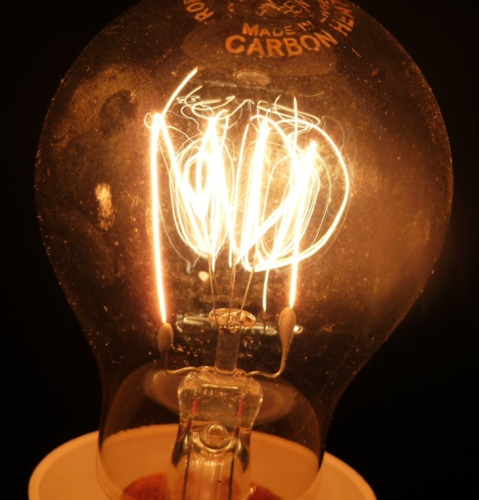
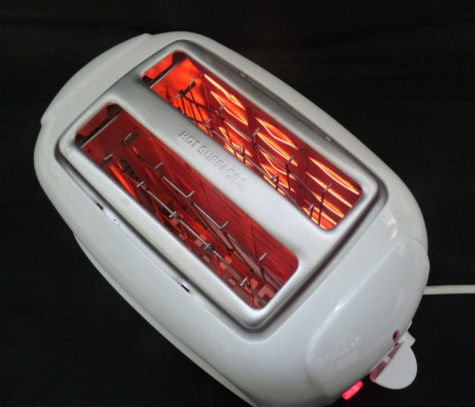
Ohmic Heating
Ohmic heating happens when a current passes through a wire, or any other conductor, and electrical energy is transferred to thermal energy. When a current flows through a wire, the wire gets hot.
This is useful in appliances such as toasters, kettles, electric cookers, electric room heaters and light bulbs, where the filament glows red or white hot as a result of ohmic heating.

Slide 5
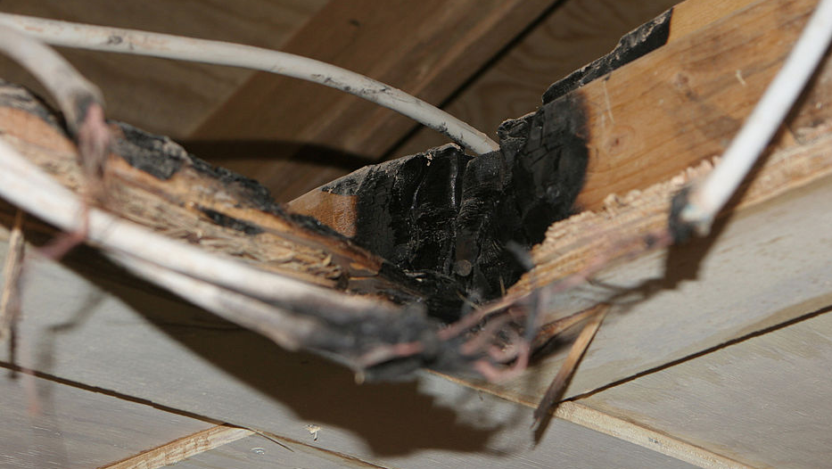
Ohmic Heating
Ohmic heating is dangerous when a large current passes through the body causing burns or when too much current flows through a wire making it get hot and either melt or catch fire.
In a domestic situation, the wiring inside the walls of the house can get hot and cause a house fire. This picture shows a fire in a roof space due to overloading the wiring.

Slide 6
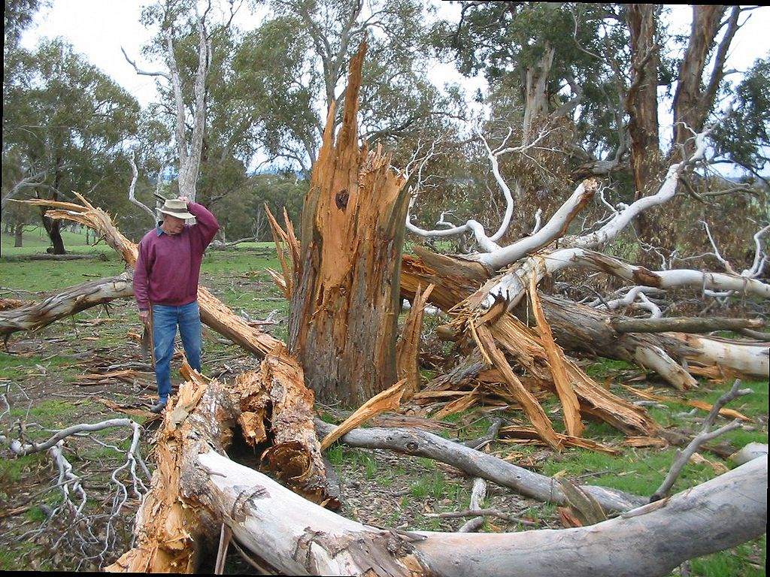
Ohmic Heating
Ohmic heating is most dramatically demonstrated in a lighting strike where a very large current flows. In the case of the tree shown opposite, the rapid heating vapourised the water in the tree causing it to explode.
The ohmic heating of the air around a lightning bolt causes it to expand and the shock wave is what we hear as thunder.
User:Cgoodwin [Attribution or Public domain], via Wikimedia Commons

Slide 7
Hazards in the Electronics Lab
The electronics lab is a safe place to work as long as normal science lab rules are followed along with a good dose of common sense. Hazards in the electronics lab might include:
Hot soldering irons and hot glue guns
Chemical hazards associated with the etching tank
Use of p.c.b. drills and other power tools
Use of circuit building tools e.g. wire cutters
Crowded work spaces and bags left lying around – trip hazard
Components of the wrong rating getting too hot
Polarised components inserted incorrectly and blowing up
YOU – or others – not using common sense

Slide 8
Working Safely
Safety in the electronics lab can be improved by:
Only working with supervision or with another person present
Knowing how to summon help and deal with an emergency
Carrying out a risk assessment of the proposed activity
Considering environmental factors such as the presence of water
Working with the power supply turned off
Understanding how to use apparatus and construct circuits before starting practical work
Not touching or dismantling unfamiliar apparatus
Being aware that some components (capacitors and inductors) can store energy even after the power supply is disconnected
Being aware that hazards exist

Slide 9
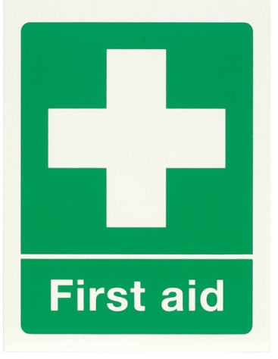
What to do in an Emergency
It is important to know what to do in an emergency, for instance, if somebody is being electrocuted, you should:
Call for help – always get help first, no matter what
Turn off the power at the mains – do not put yourself in danger
Assess the casualty and apply first aid – first aid training is useful
Keep casualty comfortable until help arrives
– warm, in the recovery position if appropriate
Consider taking of a proper first aid course

Slide 10
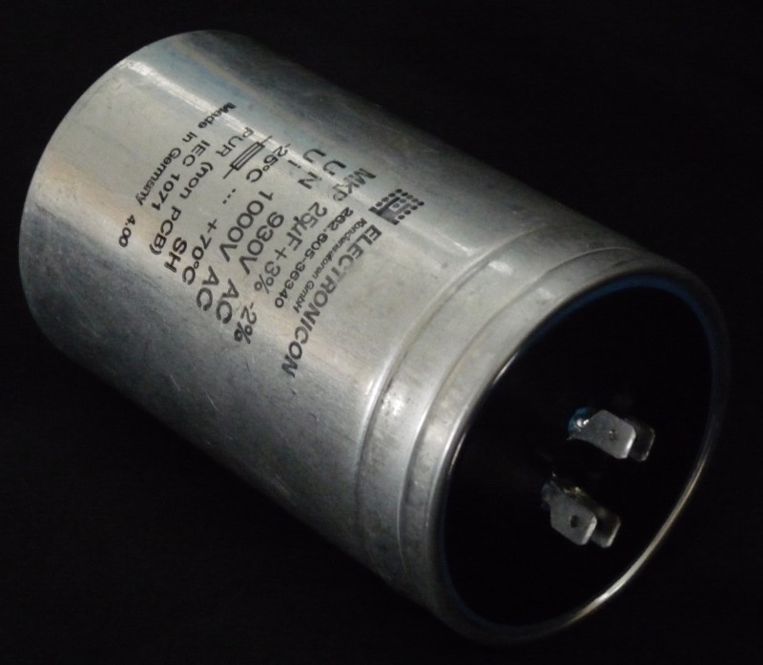
Capacitors
Capacitors are electrical components that store electrical energy.
They can store charge and energy, at a potentially very high voltage, even after the power supply has been disconnected.
The charge / energy they store can be lethal. A large value capacitor should always be treated with caution!
This is a 25μF 1000v capacitor. It would probably kill you if you touched it when it was charged … can you tell if it is charged?

Slide 11
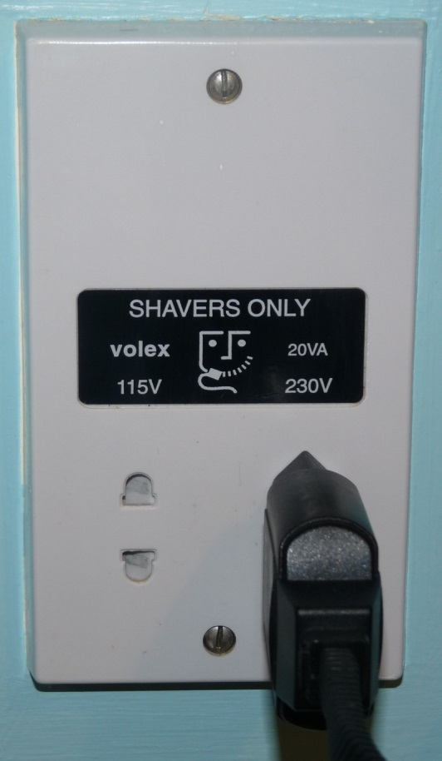
Transformers
Transformers are used to convert a high a.c. voltage to a lower, safer a.c. voltage. Transformers provide a safe, lower voltage for project work.
A different use of transformers is in the bathroom. An isolating transformer is used to provide a safe mains voltage for toothbrushes and shavers etc. The voltage from isolating transformer is not reduced but it is isolated from the actual mains. Touching either of the contacts of an isolating transformer is not hazardous ... touching both contacts is still dangerous.

Slide 12
Summary
Electrical Safety Summary:
Electric shock is where a small current through the body causes muscle spasms and can interfere with the function of the heart
A large current can cause electrical burns or start a fire
There are many hazards in the electronics lab
Never work alone and know what to do in an emergency
Capacitors can store a lethal charge even after they are disconnected from the power supply
Transformers provide a safe low voltage power source

Slide 13
Questions
What effect does current have on the human body?
What component provides a safe working voltage for electrical appliances?
What component can hold a dangerous charge even after being disconnected from the power supply?
What should you do upon discovering a casualty being electrocuted in the electronics lab?
What steps should you take to ensure safety in the electronics lab?

Slide 14
Answers
Paralysis and burns
Transformers
Capacitors
Call for help, disconnect supply or isolate casualty, apply first aid as necessary
Never work alone, complete a risk assessment, know what the hazards are, use common sense

