Slide 1
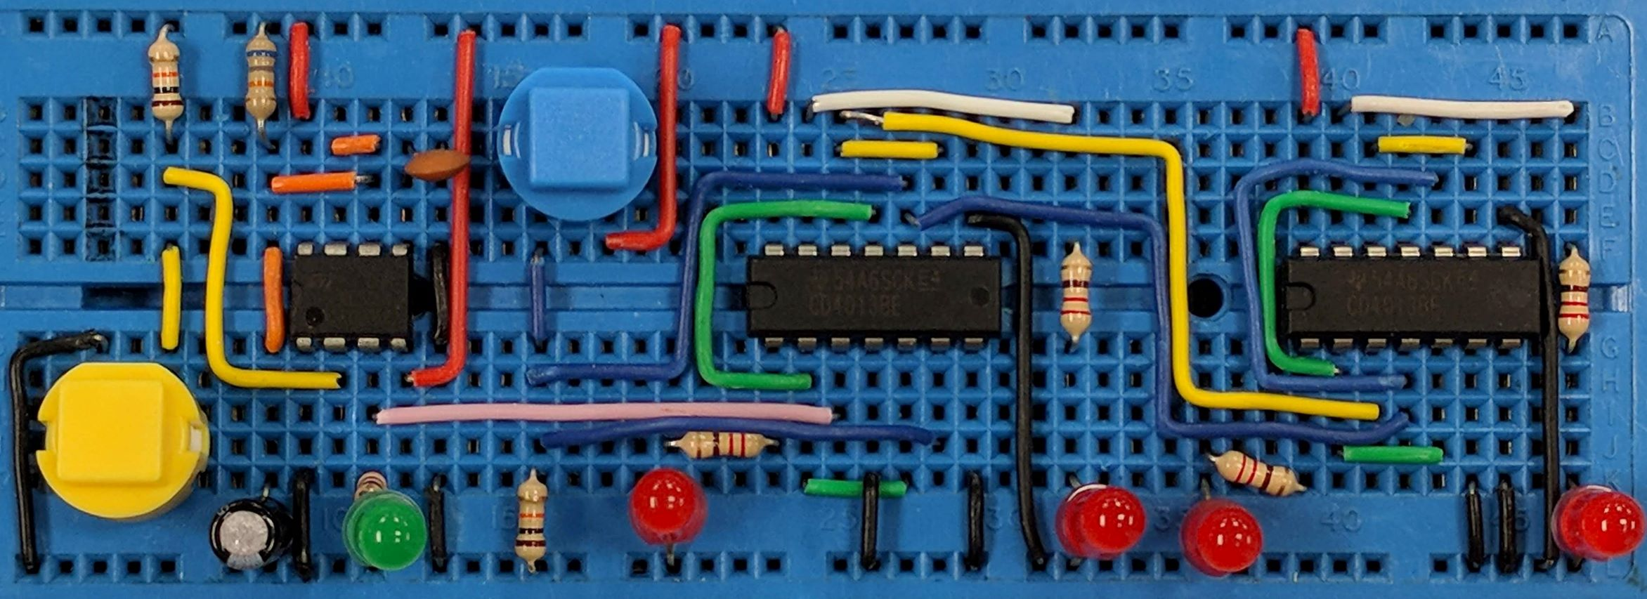
Inverting Amplifier
AIM: To understand the operation of an inverting amplifier
PRIOR KNOWLEDGE: Op-amp circuits, potential dividers, amplifier gain
www.pfnicholls.com

Slide 2
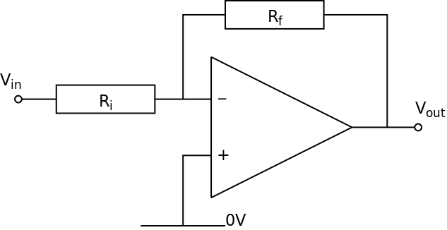
Introduction
An amplifier is an analogue circuit. An inverting amplifier is a voltage amplifier based on an Op-Amp
The output voltage (V_{out}) of the circuit depends on the input voltage (V_{in}) and the Gain (A_{v}) of the circuit
The amplifiers are assumed to have a positive and a negative power supply, usually ± 15 V, so that the output voltage can be both positive and negative

Slide 3
Basic Inverting Amplifier Circuit
The Op-Amp needs to have ± power supplies (assumed to be ± 15 V)
The non-inverting input is connected to 0 V
The circuit uses a feedback resistor (Rf) and an input resistor (Ri)
Voltage gain (Av) is determined by Rf and Ri

Slide 4
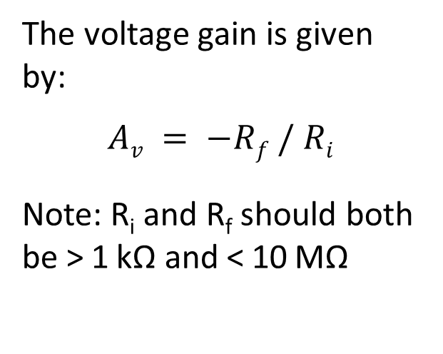
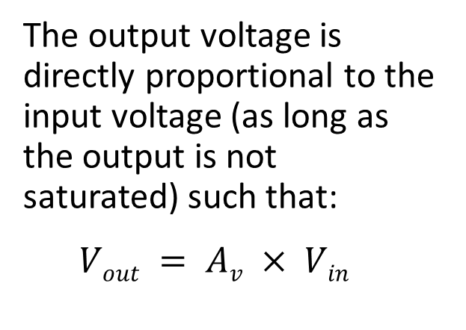
Basic Inverting Amplifier Circuit
The voltage gain is given by:
$$Av = −Rf / Ri$$
Note: R_{i} and R_{f} should both be > 1 kΩ and < 10 MΩ
Notes:
If A_{v} < 1, V_{out} < V_{in} and the input voltage has been attenuated rather than amplified
If the input voltage is positive, the output voltage is negative
If the input voltage is negative, the output voltage is positive
The output voltage is directly proportional to the input voltage (as long as the output is not saturated) such that:
$$Vout = Av × Vin$$

Slide 5
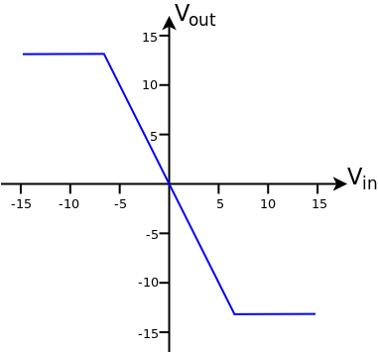
Transfer Characteristics
The graph shows the transfer characteristics (Input Voltage and Output Voltage) for an Inverting amplifier with a voltage Gain of −2
When V_{in} = +5 V then V_{out} = −10 V
when V_{in} = −5 V then V_{out} = +10 V
The Output Voltage is limited to ±13 V by the power supply of the amplifier.
When Vin > +6.5 V then V_{out} saturates at −13 V
When V_{in} < −6.5 V then V_{out} saturates at +13 V
The saturated output is shown by the horizontal lines on the graph.

Slide 6
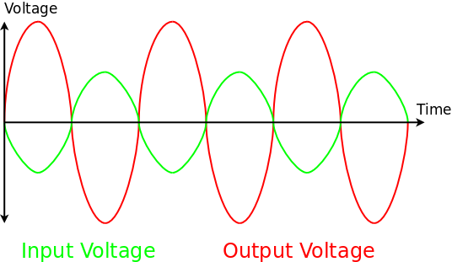
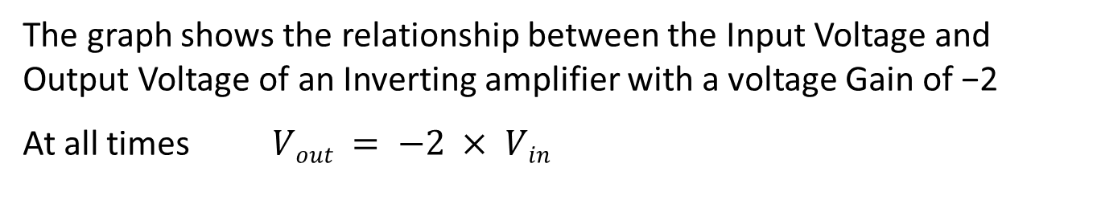
Input and Output Voltages
The graph shows the relationship between the Input Voltage and Output Voltage of an Inverting amplifier with a voltage Gain of −2
At all times $Vout = −2 × Vin$

Slide 7
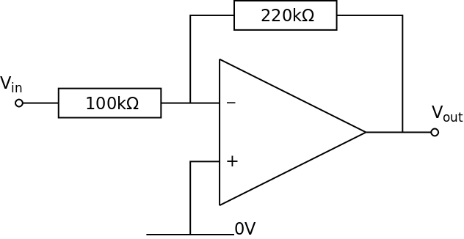
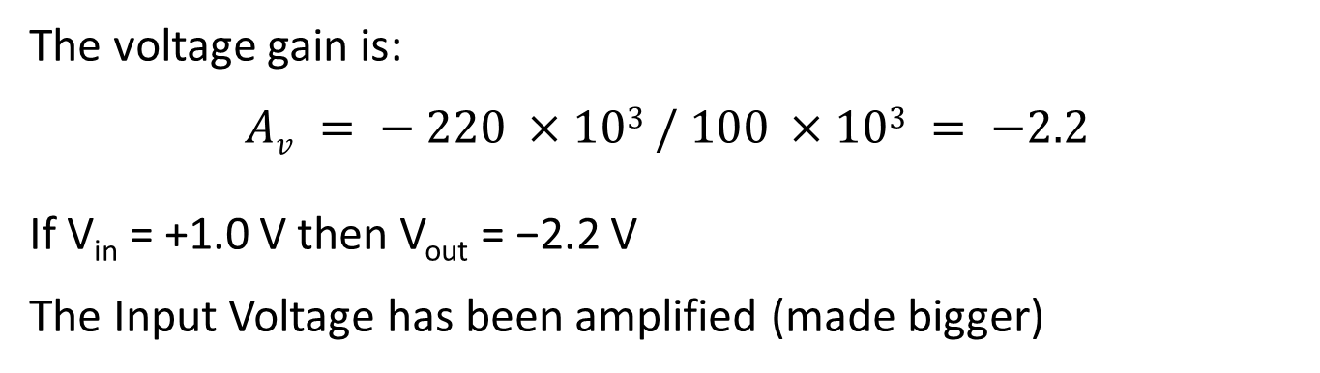
Example Circuits
The voltage gain is:
$$Av = − 220 ×103 / 100 ×103 = −2.2$$
If V_{in} = +1.0 V then V_{out} = −2.2 V
The Input Voltage has been amplified (made bigger)

Slide 8
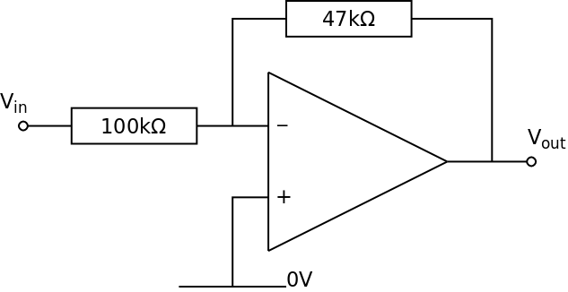
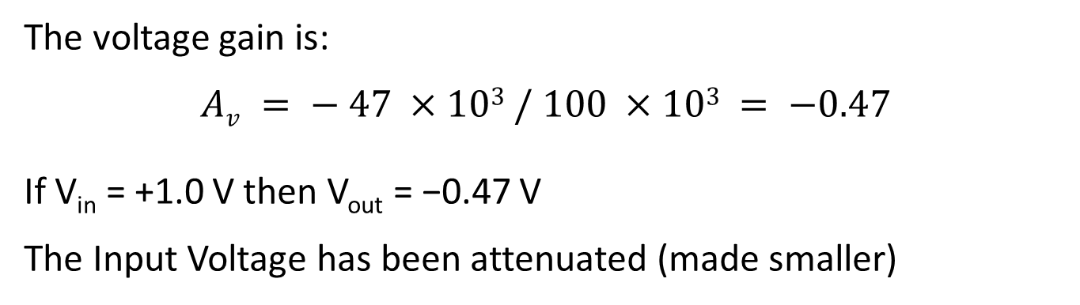
Example Circuits
The voltage gain is:
$$Av = − 47 ×103 / 100 ×103 = −0.47$$
If V_{in} = +1.0 V then V_{out} = −0.47 V
The Input Voltage has been attenuated (made smaller)

Slide 9

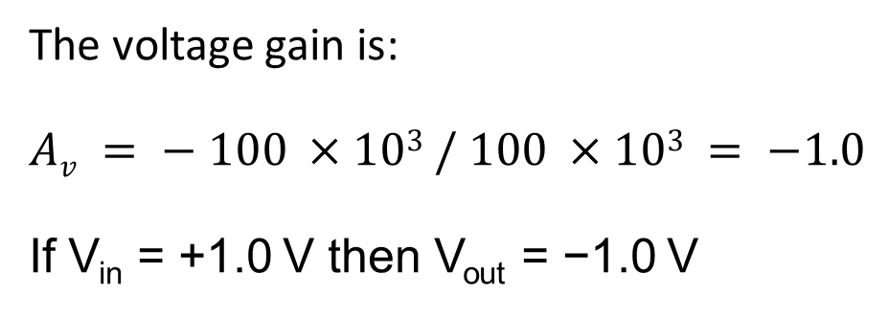
Example Circuits
This is a unit gain amplifier
The Output Voltage has the same amplitude as the Input Voltage
This amplifier is a buffer as the input takes almost no current from the voltage source but provides a reasonable current to the subsequent circuits
The voltage gain is:
$$Av = − 100 ×103 / 100 ×103 = −1.0$$
If V_{in} = +1.0 V then V_{out} = −1.0 V

Slide 10
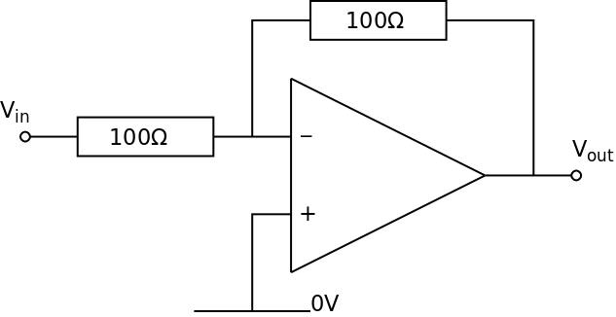
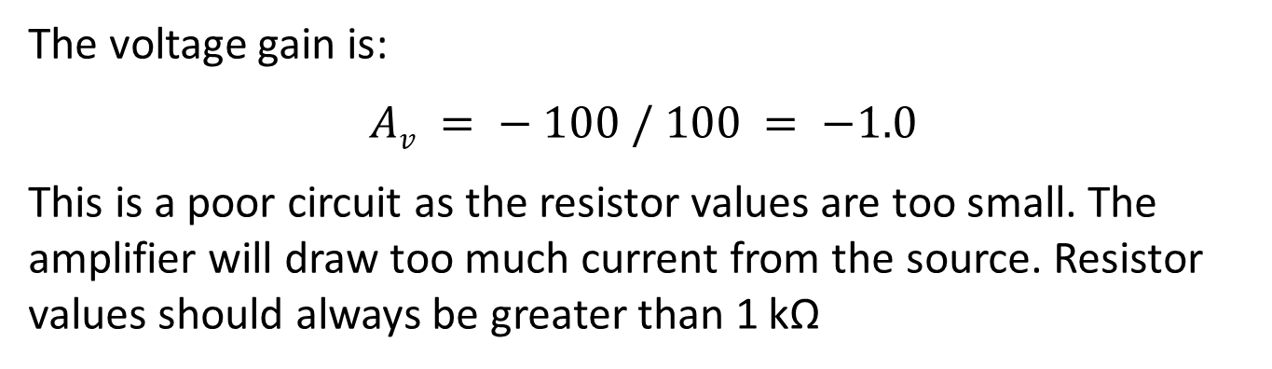
Example Circuits
The voltage gain is:
$$Av = − 100 / 100 = −1.0$$
This is a poor circuit as the resistor values are too small. The amplifier will draw too much current from the source. Resistor values should always be greater than 1 kΩ

Slide 11
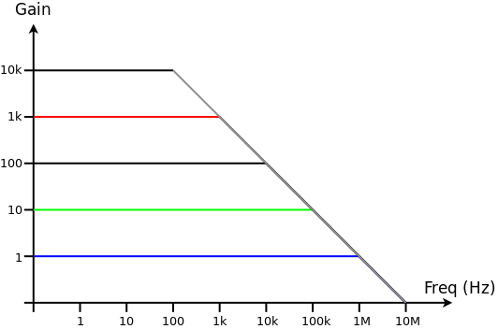
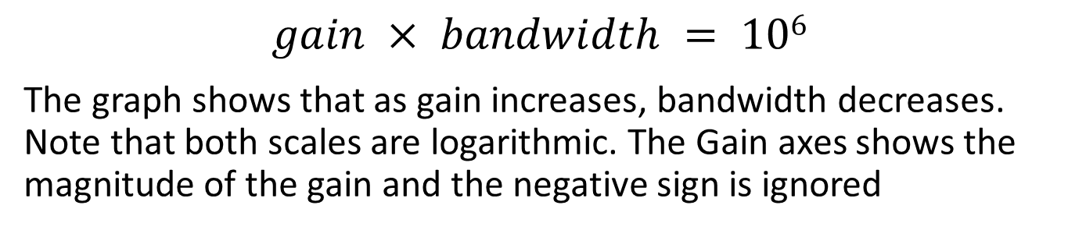
Gain and Bandwidth
The two main parameters of the Inverting Amplifier are the gain and the bandwidth
Increasing the gain reduces the bandwidth and vice versa
For an inverting amplifier based on a standard Op-Amp the relationship between gain and bandwidth is approximately:
$$gain × bandwidth = 106$$
The graph shows that as gain increases, bandwidth decreases. Note that both scales are logarithmic. The Gain axes shows the magnitude of the gain and the negative sign is ignored

Slide 12
Gain and Bandwidth
When the gain is ×1 (blue line) the amplifier works effectively up to frequencies of 1 MHz
If the gain is increased to ×10 (green line) the amplifier only works effectively up to about 100 kHz. This is still suitable for audio
At a gain of ×1000 (red line) the amplifier only works effectively up to a frequency of 1 KHz before the gains starts to reduce and the Output voltage starts to decrease
If the gain is −100, the bandwidth is 10 kHz
If a bandwidth of 40 kHz is required, the maximum gain is −25

Slide 13
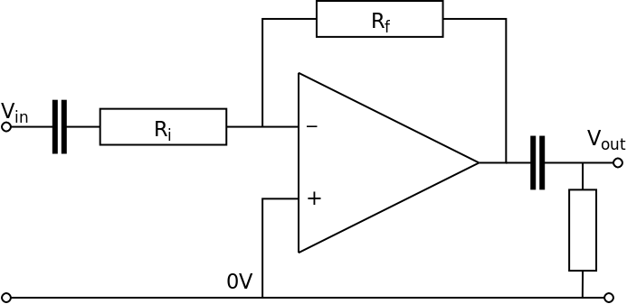
Better Amplifier Circuit
When used in reality, amplifiers are often decoupled which means that the input and output are connected through capacitors to stop any spurious D.C. signals compromising the performance of the amplifier
Depending on what circuit or transducer the amplifier is attached to, a resistor may also be needed on the output down to 0 V.

Slide 14
Better Amplifier Circuit
The capacitor on the input is usually a non-electrolytic type, nominally 1 µF or less. The capacitor on the output is ideally a non-electrolytic type but sometimes larger value electrolytic capacitors need to be used if the amplifier is providing significant current to the next stage.
The addition of capacitors to the input and output can reduce the bandwidth of the amplifier.

Slide 15
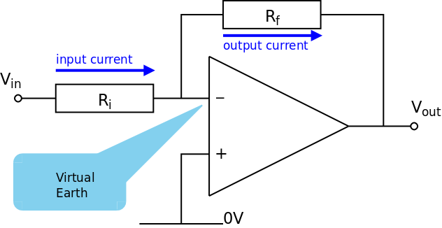
How the inverting amplifier works
When considering amplifiers made from Op-Amps there are two basic assumptions:
The open loop gain (A₀) of the Op-Amp is very large
No current flows in to the inverting and non-inverting inputs

Slide 16
Negative Feedback
Recall that V_{out} = A₀ × (V₊ − V₋) where A₀ = 10⁶ and so a difference between V₊ and V₋ of more than a few µV will result in a large (saturated) output voltage
The feedback resistor ensures that voltage at the inverting input is very similar (within a few microvolts) to the voltage at the non-inverting input
As the non-inverting input is connected to ground (0 V) then the inverting input must also be very close to 0 V and is called a virtual earth
R_{i} and R_{f} form a potential divider with V_{in} at one end, V_{out} at the other end and the inverting input at approximately 0 V in the middle
The feedback works because if V_{in} is positive and rises, the voltage at the inverting input rises as a consequence. This increases the difference between the inverting and non-inverting inputs and causes V_{out} to change. As the inverting input is bigger than the non-inverting input in this case then V_{out} becomes more negative. As V_{out} becomes more negative the voltage at the inverting input falls again until it is approximately 0 V once more. Therefore a change in the input voltage causes an opposing change in the output voltage to keep the inverting input at (or very close to) zero

Slide 17
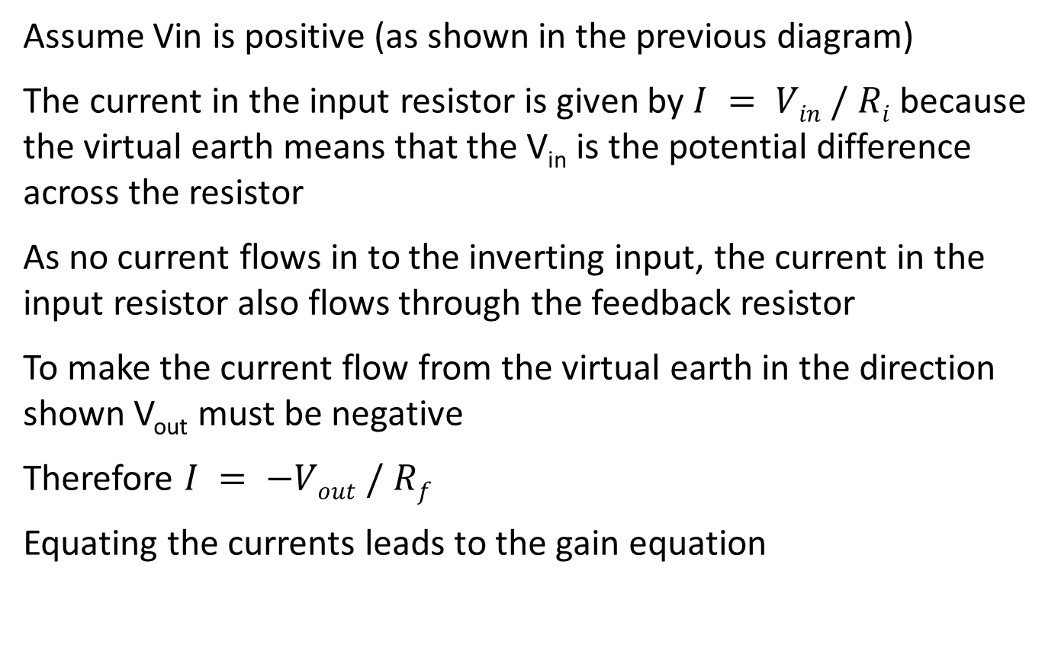
Gain Equation
Assume Vin is positive (as shown in the previous diagram)
The current in the input resistor is given by $I = Vin / Ri$because the virtual earth means that the V_{in} is the potential difference across the resistor
As no current flows in to the inverting input, the current in the input resistor also flows through the feedback resistor
To make the current flow from the virtual earth in the direction shown V_{out} must be negative
Therefore $I = −Vout / Rf$
Equating the currents leads to the gain equation

Slide 18

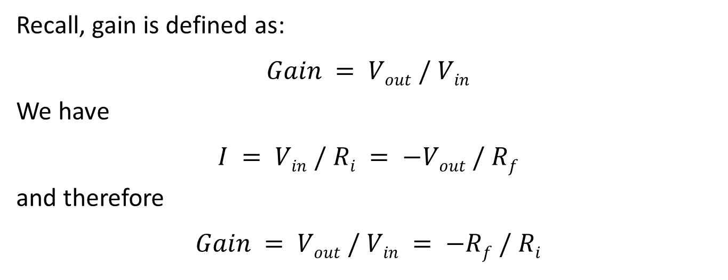
Gain Equation part 2
Recall, gain is defined as:
$$Gain = Vout / Vin$$
We have
$$I = Vin / Ri = −Vout / Rf$$
and therefore
$$Gain = Vout / Vin = −Rf / Ri$$

Slide 19
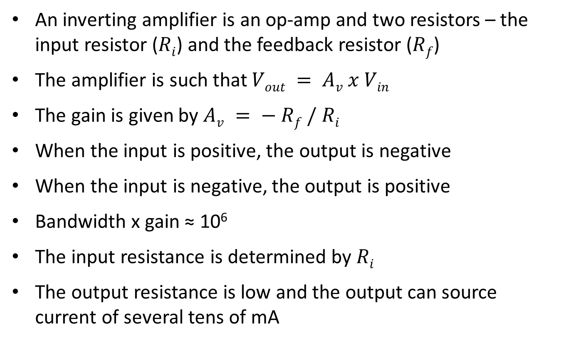
Summary
An inverting amplifier is an op-amp and two resistors – the input resistor ($Ri$) and the feedback resistor ($Rf$)
The amplifier is such that $Vout = Av x Vin$
The gain is given by $Av = − Rf / Ri$
When the input is positive, the output is negative
When the input is negative, the output is positive
Bandwidth x gain ≈ 10⁶
The input resistance is determined by $Ri$
The output resistance is low and the output can source current of several tens of mA

Slide 20
Questions
For an op-amp based inverting amplifier, the gain is – 10 and the input voltage is – 500 mV. What is the output voltage ?
An inverting amplifier has a gain of – 40 and an input resistor of value R_{i} = 20 kΩ. What value is required for R_{f} ?
An inverting amplifier has a gain of – 100 and a feedback resistor of R_{f} = 470 kΩ. What is the value of R_{i} ?
An amplifier has R_{i} = 22 kΩ and R_{f} = 330 kΩ. What is the gain of the amplifier ?
An amplifier has a gain of – 50. What is the maximum bandwidth of the amplifier?
Why must R_{i} be greater than 1 kΩ ?

Slide 21
Answers
V_{out} = + 5 V V_{out} = - 0.5 x - 10 = + 5 V 500 mV = 5 V
A_{v} = - R_{f} / R_{i} - 40 = - R_{f} / 20 k R_{f} = 800 kΩ
A_{v} = - R_{f} / R_{i} - 100 = - 470 k / R_{i} R_{i} = 4.7 kΩ
A_{v} = - R_{f} / R_{i} A_{v} = - 330 k / 22 k A_{v} = - 15
Bandwidth = 10⁶ / gain Bandwidth = 10⁶ / 50 = 20 kHz
So that the input current is not too big (which might affect the behaviour of the circuit before the amplifier). The input current taken by the amplifier should be as small as possible and therefore the input resistance should be as large as possible.

