Slide 1
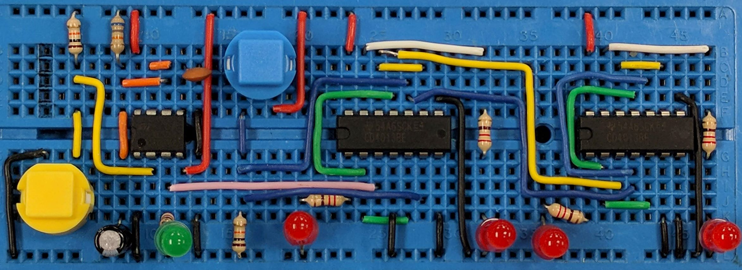
Non-Inverting Amplifier
AIM: To understand the function of an op-amp based non-inverting amplifier
PRIOR KNOWLEDGE: Op-amps, amplifier gain and bandwidth, potential dividers
www.pfnicholls.com

Slide 2
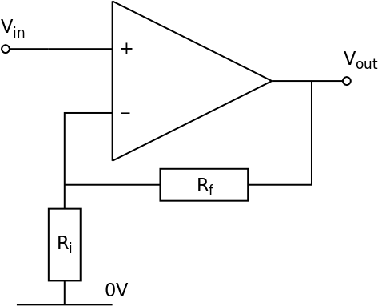
Introduction
An amplifier is an analogue circuit. A non-inverting amplifier is a voltage amplifier and can be based around an op-amp.
The output voltage (V_{out}) of the circuit depends on the input voltage (V_{in}) and the Gain (A_{v}) of the circuit.
For all the circuits shown below, the amplifier is assumed to a have a positive and a negative power supply, usually ±15 V, so that the output voltage can be both positive and negative.

Slide 3
Non-Inverting Amplifier Circuit
The input, Vin, is connected directly to the non-inverting input
The circuit uses a feedback resistor (Rf) and an input resistor (Ri) to feedback a fraction of the output voltage to the inverting input. Rf and Ri form a potential divider
Ri is not the actual input resistor but the same naming convention is used to be consistent with the inverting amplifier
Voltage gain (Av) is determined by Ri and Rf
The Op-Amp needs to have ± power supplies
(assumed to be ±15 V)

Slide 4
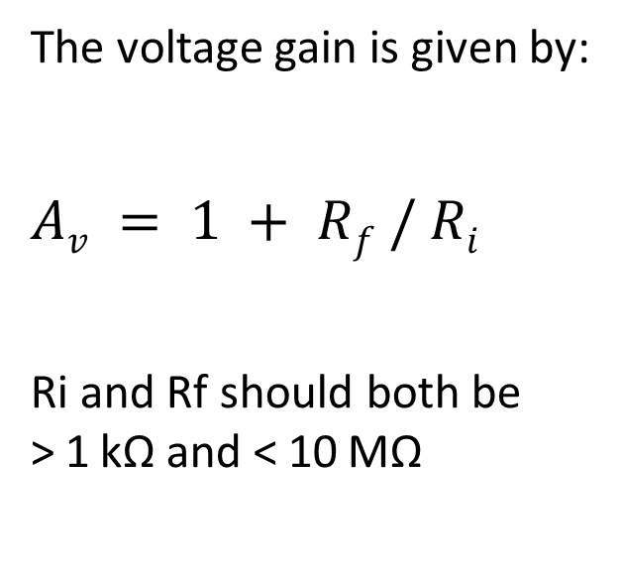
Non-Inverting Amplifier Circuit
The voltage gain is given by:
$$Av = 1 + Rf / Ri$$
Ri and Rf should both be > 1 kΩ and < 10 MΩ
The voltage gain of the Non-Inverting amplifier cannot be less than unity (1) and so this amplifier cannot be used to attenuate signals

Slide 5
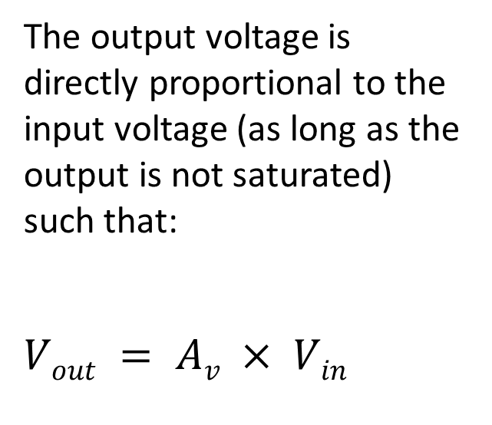
Function of the Non-Inverting Amplifier
The output voltage is directly proportional to the input voltage (as long as the output is not saturated) such that:
$$Vout = Av × Vin$$
If the input voltage is positive, the output voltage is also positive
If the input voltage is negative, the output voltage is also negative

Slide 6
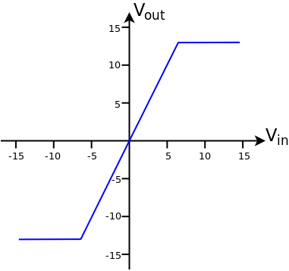
Transfer Characteristics
The graph shows the transfer characteristics (Input Voltage and Output Voltage) for a Non-Inverting amplifier with a voltage Gain of +2
When Vin = +5 V, Vout = +10 V When Vin = −5 V, Vout = −10 V
The Output Voltage is limited to ±13 V by the power supply of the amplifier. Therefore, when Vin > +6.5 V, Vout saturates at +13 V and when Vin < −6.5 V, Vout saturates at −13 V
The saturated output is shown by horizontal lines on the graph

Slide 7
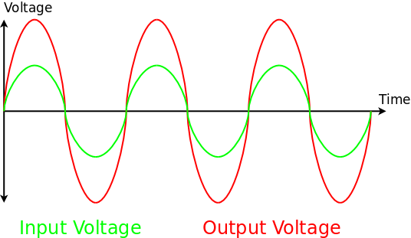
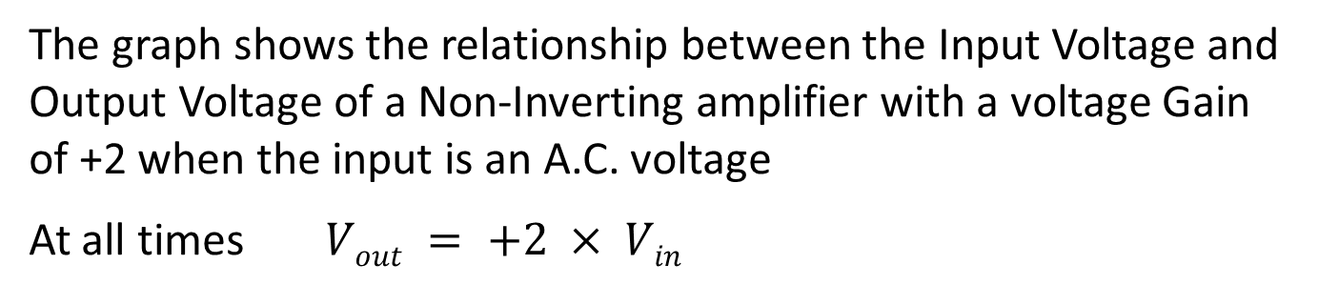
Transfer Characteristics
The graph shows the relationship between the Input Voltage and Output Voltage of a Non-Inverting amplifier with a voltage Gain of +2 when the input is an A.C. voltage
At all times $Vout = +2 × Vin$

Slide 8
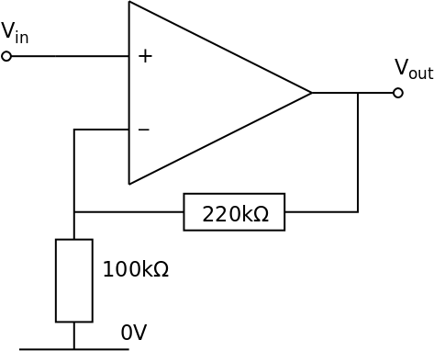
Example Circuit
The voltage gain is:
Av = 1 + (220 ×10³ / 100 ×10³) = +3.2
If Vin = +1.0 V then Vout = +3.2 V
The Input Voltage has been amplified (made bigger)

Slide 9
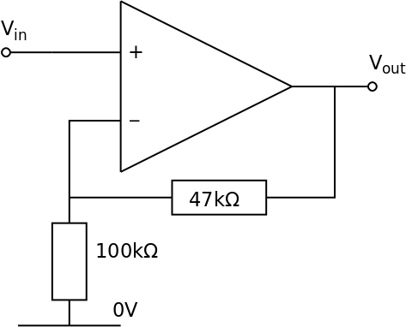
Example Circuit
The voltage gain is:
Av = 1 + (47 ×10³ / 100 ×10³) = +1.47
If Vin = +1.0 V then Vout = +1.47 V
The Input Voltage has been amplified even though Rf is smaller than Ri

Slide 10

Example Circuit
The voltage gain is:
Av = 1 + (100 ×10³ / 100 ×10³) = +2.0
If Vin = +1.0 V then Vout = +2.0 V
The Input Voltage has been amplified by a factor of two when Ri = Rf

Slide 11
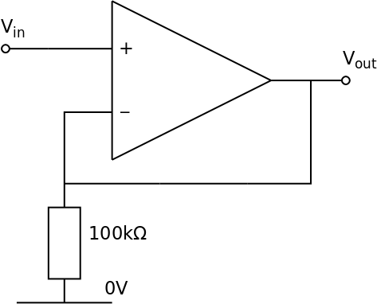
Example Circuit
The voltage gain is:
Av = 1 + 0 / 100 ×10³ = +1.0
This is a unit gain amplifier
The Output Voltage has the same amplitude as the Input Voltage
This amplifier is a buffer as the input takes almost no current from the voltage source but provides a reasonable current to the subsequent circuits

Slide 12
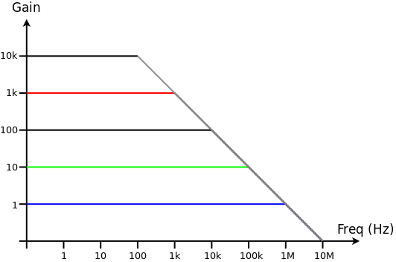

Gain and Bandwidth
The two main parameters of the Inverting Amplifier are the gain and the bandwidth. Increasing the gain reduces the bandwidth and vice versa
For a Non-Inverting amplifier based on a standard Op-Amp the relationship between gain and bandwidth is approximately:
$$gain × bandwidth = 106$$

Slide 13
Gain and Bandwidth
When the gain is ×1 (blue line) the amplifier works effectively up to frequencies of 1 MHz
If the gain is increased to ×10 (green line) the amplifier only works effectively up to about 100 kHz (still okay for audio)
At a gain of ×1000 (red line) the amplifier only works effectively up to a frequency of 1 kHz before the gains starts to reduce

Slide 14
Gain and Bandwidth
If the gain is +100, the bandwidth is 10 kHz
If a bandwidth of 40 kHz is required, the maximum gain is +25

Slide 15
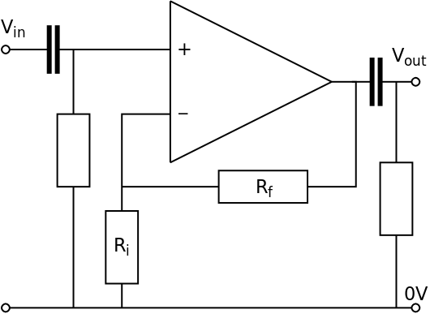
Better Non-Inverting Amplifier Circuit
When used in reality, amplifiers are often decoupled which means that the input and output are connected through capacitors to stop any spurious D.C. signals compromising the performance of the amplifier.
Depending on what the amplifier is attached to, a resistor may also be needed on the output down to 0 V
The input resistance of the Op-Amp is very high, meaning that small currents can become relatively large voltages (V=I×R) at the input increasing the random noise of the amplifier. To avoid this, an input resistor is often connected to ground to lower the effective input resistance of the amplifier.

Slide 16
Better Non-Inverting Amplifier Circuit
The capacitor on the input is usually a non-electrolytic type, nominally 1 µF or less. The capacitor on the output is ideally a non-electrolytic type but sometimes larger value electrolytic capacitors need to be used if the amplifier is providing significant current to the next stage
The addition of capacitors and resistors to the input and output can reduce the bandwidth of the amplifier

Slide 17
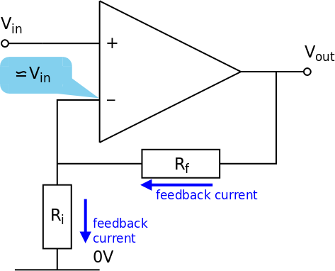
How the Non-Inverting Amplifier Works
When considering amplifiers made from Op-Amps there are two basic assumptions:
The open loop gain (A0) of the Op-Amp is very large
No current flows into the inverting and non-inverting inputs

Slide 18
How it works: Negative feedback
Recall that Vout = A0 × (V+ − V−) where A0 = 10⁶ and so a difference between V+ and V− of more than a few µV will result in a large (saturated) output voltage
The feedback resistor ensures that voltage at the inverting input is very similar (within a few microvolts) to the voltage at the non-inverting input
As the non-inverting input is connected directly to the Input Voltage (Vin) then the inverting input must also be very close to the Input Voltage - within a few µV or so
Rf and Ri form a potential divider with Vout at one end, 0 V at the other end and the inverting input at approximately Vin in the middle
The feedback works because if Vin is positive and rises, the voltage at the output rises very rapidly as a consequence because there is a difference between the inverting and non-inverting inputs which causes Vout to change. As the non-inverting input is bigger than the inverting input in this case then Vout becomes more positive. As Vout becomes more positive, the voltage at the inverting input also rises until it is approximately Vin once more. Therefore a change in the Input Voltage causes a corresponding change in the Output Voltage to keep the inverting input at (or very close to) the non-inverting input

Slide 19
How it works: Gain Equation
Assume Vin is positive (as shown in the diagram previously)
The feedback current in the input resistor is given by I = Vin / Ri because the voltage at the inverting input is Vin due to the negative feedback and so this is the potential difference across the resistor
As no current flows in to the inverting input, the current in the input resistor also flows through the feedback resistor
To make current flow through the feedback resistor as shown, Vout must be greater than Vin
The potential difference across the feedback resistor is therefore Vout − Vin
Therefore, I = (Vout − Vin) / Rf
Equating the currents leads to the gain equation

Slide 20

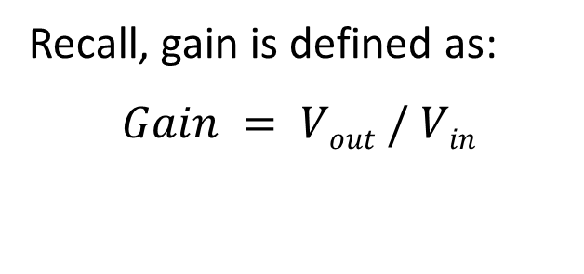
How it works: Gain Equation
Recall, gain is defined as:
$$Gain = Vout / Vin$$
We have
$$I = Vin / Ri = (Vout − Vin) / Rf$$
and therefore
$$Gain = Vout / Vin = 1 + (Rf / Ri)$$

Slide 21
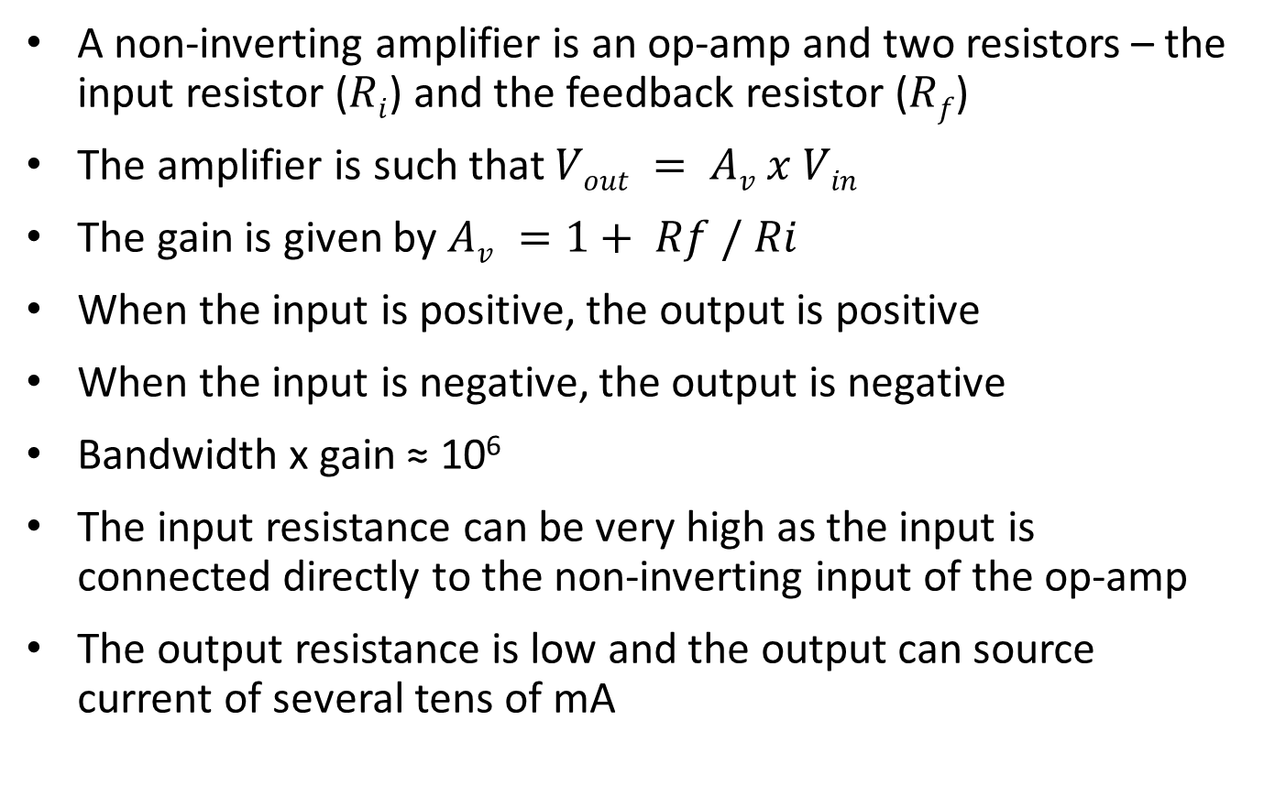
Summary
A non-inverting amplifier is an op-amp and two resistors – the input resistor ($Ri$) and the feedback resistor ($Rf$)
The amplifier is such that $Vout = Av x Vin$
The gain is given by $Av =1+ Rf / Ri$
When the input is positive, the output is positive
When the input is negative, the output is negative
Bandwidth x gain ≈ 10⁶
The input resistance can be very high as the input is connected directly to the non-inverting input of the op-amp
The output resistance is low and the output can source current of several tens of mA

Slide 22
Questions
For an op-amp based non-inverting amplifier, the gain is +10, the input voltage is – 50 mV. What is the output voltage ?
A non-inverting amplifier has a gain of +40 and an input resistor of value R_{i} = 20 kΩ. What value is required for R_{f} ?
A non-inverting amplifier has a gain of +12 and a feedback resistor of R_{f} = 330 kΩ. What is the value of R_{i} ?
A non-inverting amplifier has R_{i} = 22 kΩ and R_{f} = 330 kΩ. What is the gain of the amplifier ?
A non-inverting amplifier has a gain of +50. What is the maximum bandwidth of the amplifier?
Why must R_{f} be less than 1 MΩ ?

Slide 23
Answers
+ 10 x – 50 = – 500 mV = – 0.5 V
780 kΩ 40 = 1 + 20k/780k
30 kΩ 12 = 1 + 330/30
+16 16 = 1 + 330/22
20 kHz 1 x 10⁶ / 50 = 20 x 10³
To prevent small random currents (circuit noise) becoming significant voltages

